Slide 1
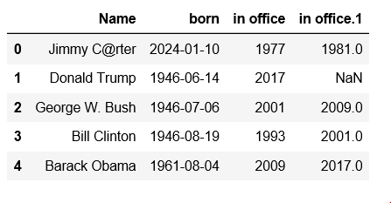
Index
Column Values
Column names
Row

Slide 2
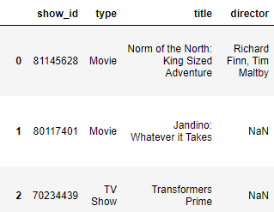
Index
Name
Column names
Index Axis = 1,
Aka Column Axis
Missing data
Index
Lables
Row values
Index Axis=0
Aka Row Axis
Column Values

